Slide 1






PHEOCConnect: A Digital Platform Strengthening County-Level Public Health Emergency Coordination in Kenya
Nelson Kilimo^{1,*}, Jude Oduor ¹ , Moses Sirigwa¹
Department of Public Health and Sanitation, Busia County, Kenya
* Corresponding author: Email: kipkilimo@gmail.com
Technological advancements in public health
Kenya Health Security Convention | 5th – 8th May 2026 | Mombasa - Kenya

Slide 2


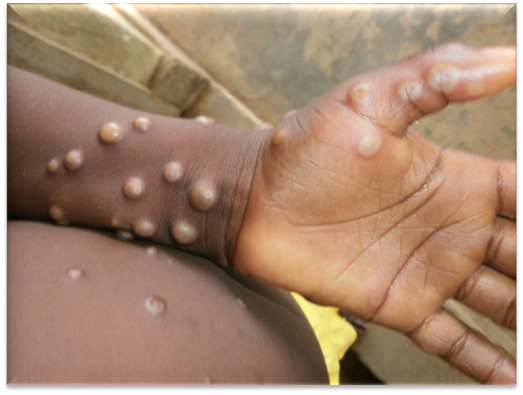


Background
Disease dynamics are increasing across our borders counties like Busia, Migori, and Moyale,
Existing EOC communication and information transmission systems are mostly linear,
Surveillance and response data remain siloed, are not automatically linked into a unified response

Slide 3
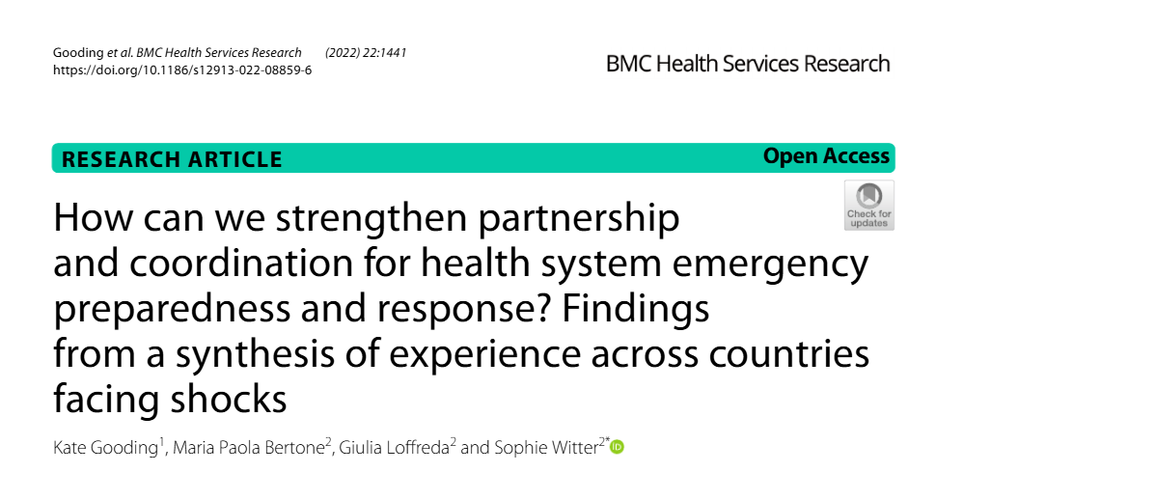
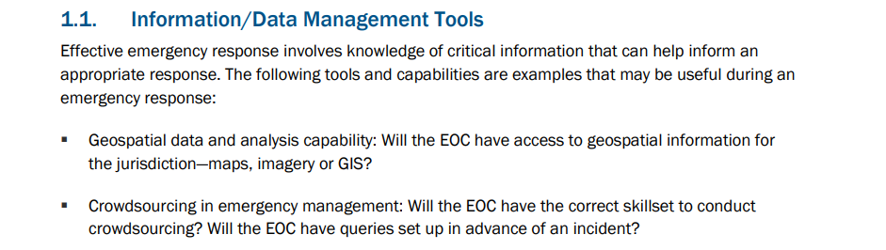
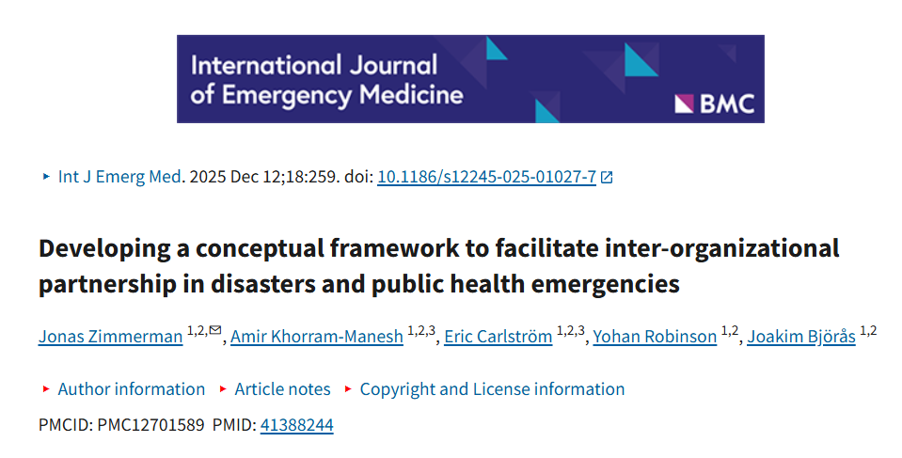
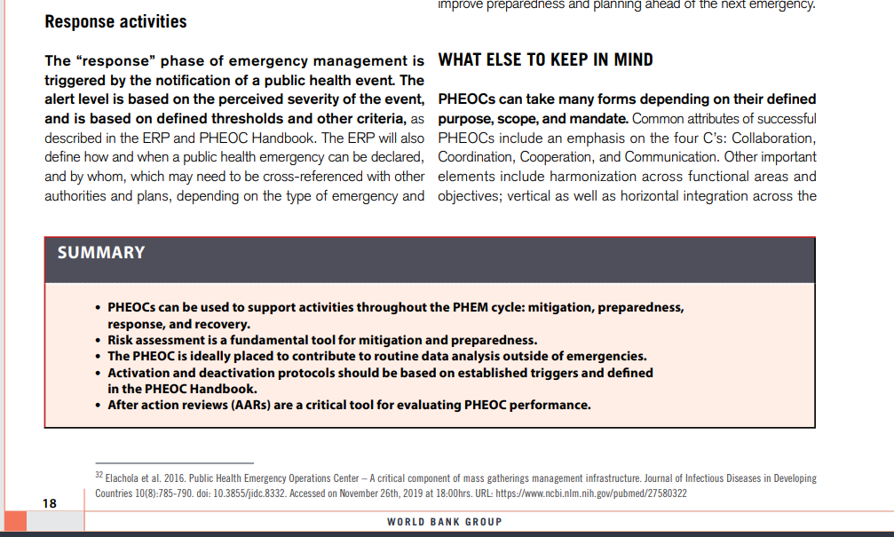
“Collaboration, Coordination, Cooperation and Communication”

Slide 4
Objectives
Broad Objective
To establish an integrated, secure, and interoperable cross-border Public Health Emergency Operations Centre (PHEOC) mesh network that enhances real-time disease surveillance, information sharing, and coordinated outbreak response across counties.
Main Objectives
  To establish a real-time cross-border emergency intelligence network
  To integrate fragmented surveillance and response systems into a unified interoperable mesh network
  To standardize emergency data structures and alert protocols across EOCs
  To strengthen coordinated outbreak response and decision-making across

Slide 5
Methodology
Field-informed, iterative, systems-oriented design grounded in real workflows and coordination gaps
Continuous co-design with EOC coordinators, surveillance teams, and response units
Iterative refinement driven by operational feedback and field use
Modular, API-driven architecture enabling interoperability and scalability
Rapid prototyping with scenario simulations aligned to routine and emergency response workflows

Slide 6
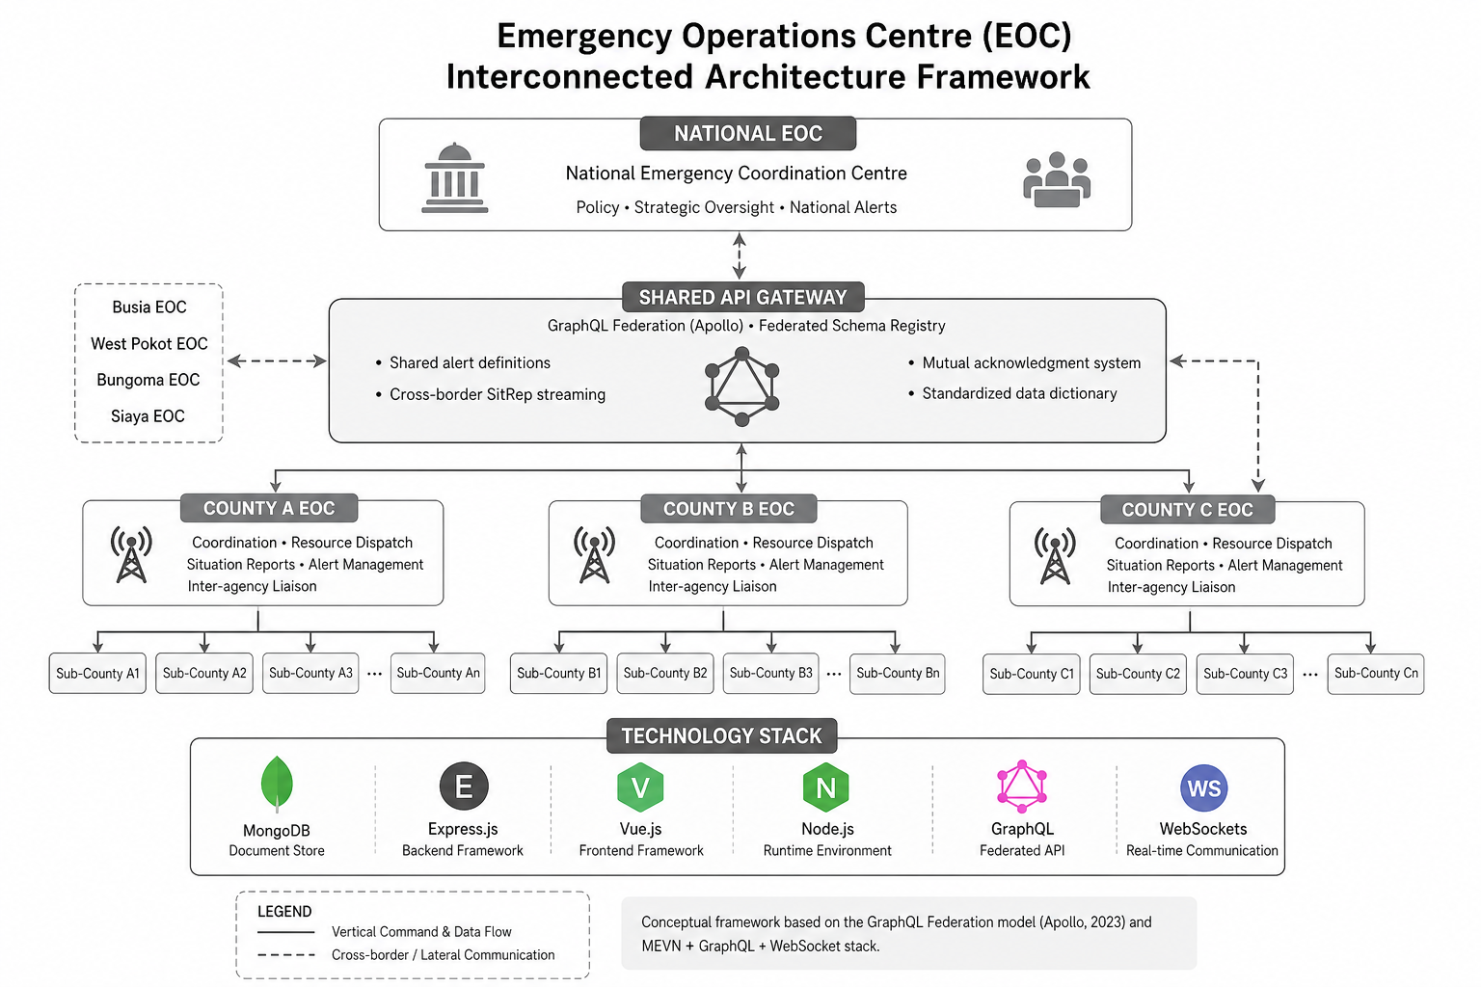

Methodology

Slide 7
Results
Developed and deployed a beta highly interconnected secure PHEOC information management system
Architecture enables interoperability across Busia, Bungoma, and Siaya validation sites while preserving local autonomy, potential for scale.
Implemented shared alert definitions for harmonized outbreak detection and escalation across counties Integrated mutual acknowledgment system + standardized data dictionary for reliable, semantically consistent data exchange
Launched live beta platform (https://pheocconnect.org) demonstrating federation, dashboards, and APIs - stakeholders invited for testing and co-development and feedback

Slide 8
Discussion
Builds on existing national coordination structures, PHEOCConnect enables complementary decentralized coordination across counties
Enhances timeliness of outbreak detection and response through real-time, peer-to-peer alert sharing alongside established reporting channels
PHEOCConnect strengthens cross-border collaboration by enabling neighboring counties to directly exchange SitReps and signals within the national framework
Improves system resilience and continuity, complementing centralized systems by reducing risks associated with single points of failure
Enables scalable, modular expansion, allowing additional counties and partners to integrate seamlessly without disrupting existing systems

Slide 9
Conclusion
Interconnectivity (mesh) PHEOC architecture can strengthen existing national systems by enabling real-time interconnectivity across counties
Enhances the timeliness and quality of epidemic intelligence through standardized data models and API-driven integration
Operationalizes cross-county and cross-border collaboration within current policy and governance frameworks

Slide 10
Policy Impact and Implications
Strengthens existing national PHEOC frameworks by adding an interconnectivity layer that enhances coordination while preserving current governance structures
Supports interoperability and digital health strategies through standardized data models and API-based integration aligned with modern architectures
Improves timeliness and quality of epidemic intelligence, enabling faster, evidence-based decision-making across interconnected county and national systems
Advances cross-county and cross-border preparedness, operationalizing real-time collaboration beyond administrative boundaries within existing legal frameworks

Slide 11
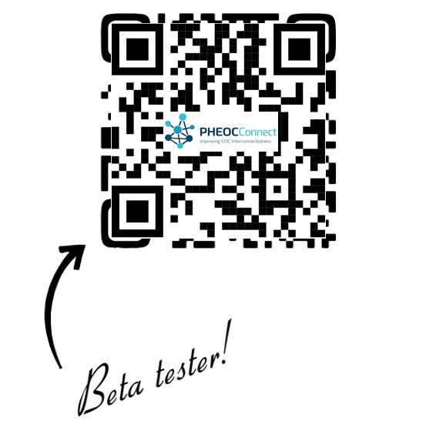






Thank you!
Scan to visit our website
pheocconnect.org
#KeHSCon2026 #PHEOCConnect
@NPHIKenya
www.nphi.go.ke

